Slide 1
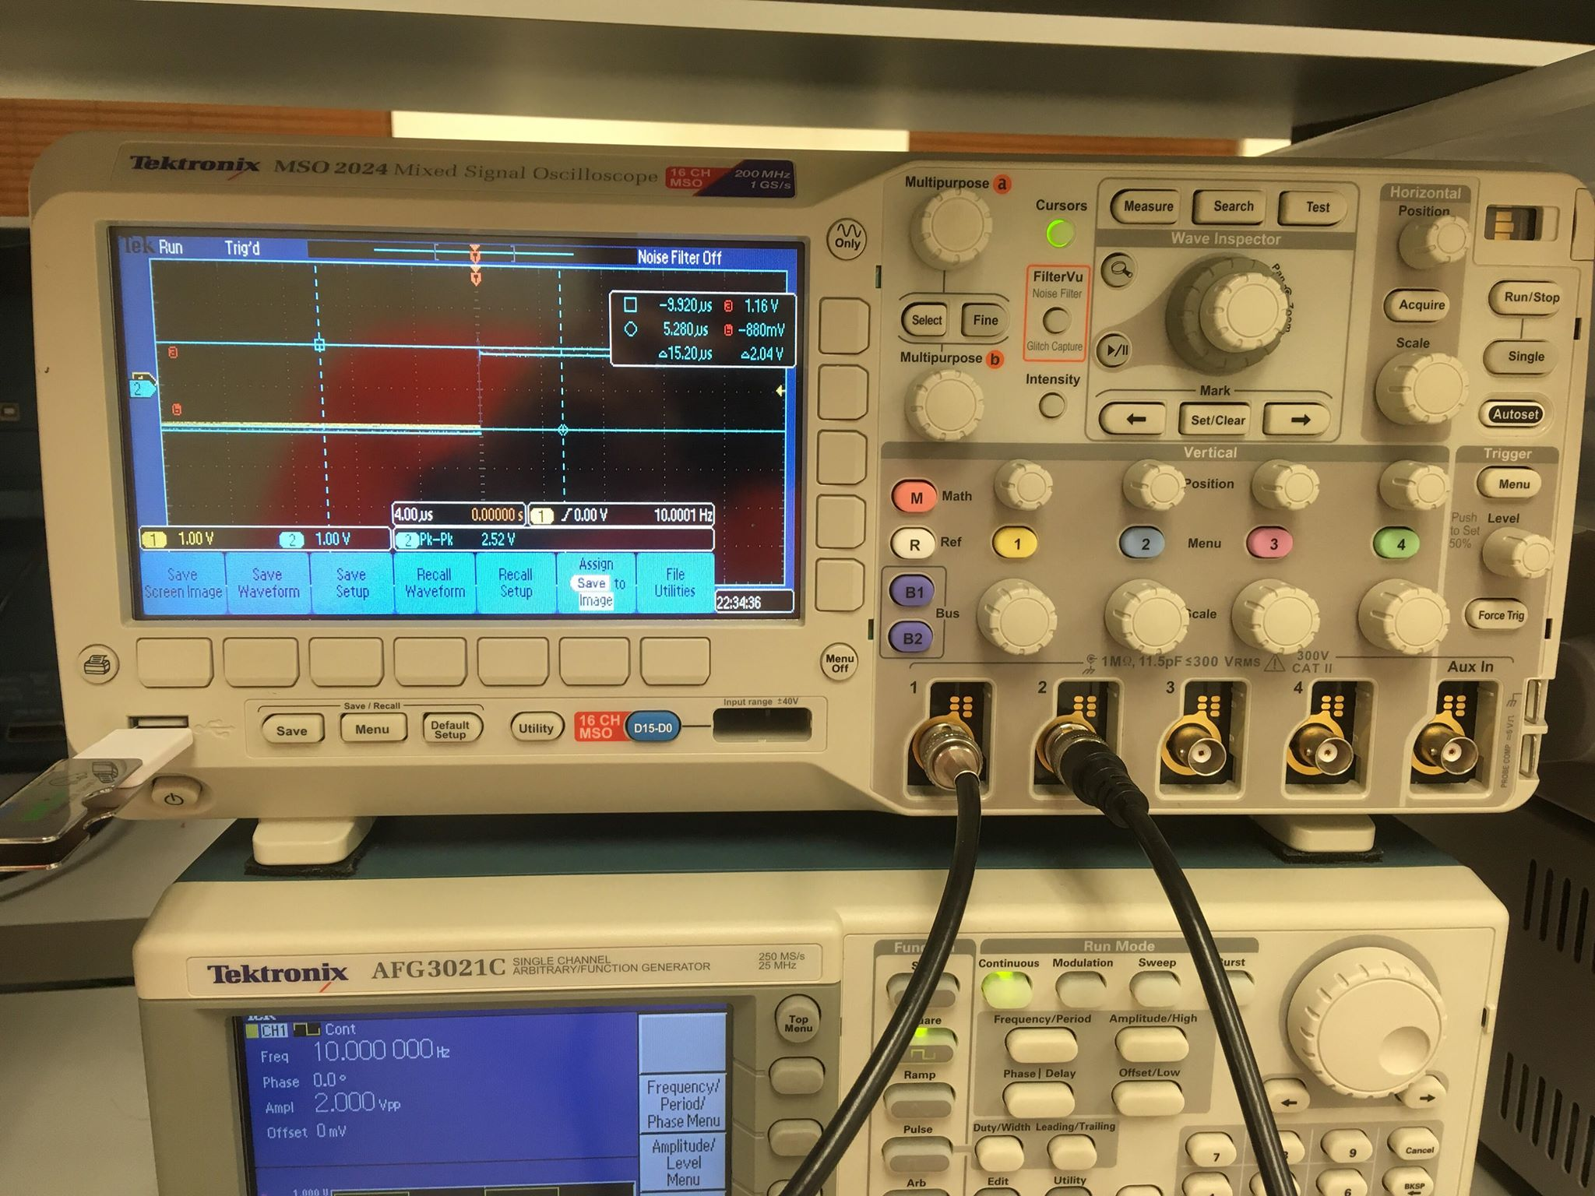
Cursors in Oscilloscope
Cursors
Position-a
Position-b
Channel 1 settings
Channel 1 display

Slide 2
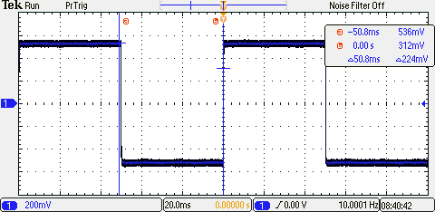
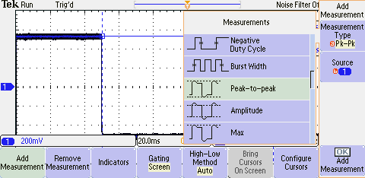
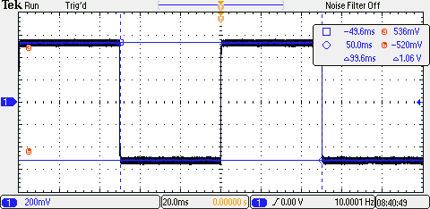
Cursors
Measure
Position-a
Press Cursor button once -> Cursors sweep along horizontal axis
Position-b
Press Cursor button twice -> Cursors sweep along vertical axis
Also add measurements by pressing measure button and selecting peak to peak and Source

Slide 3
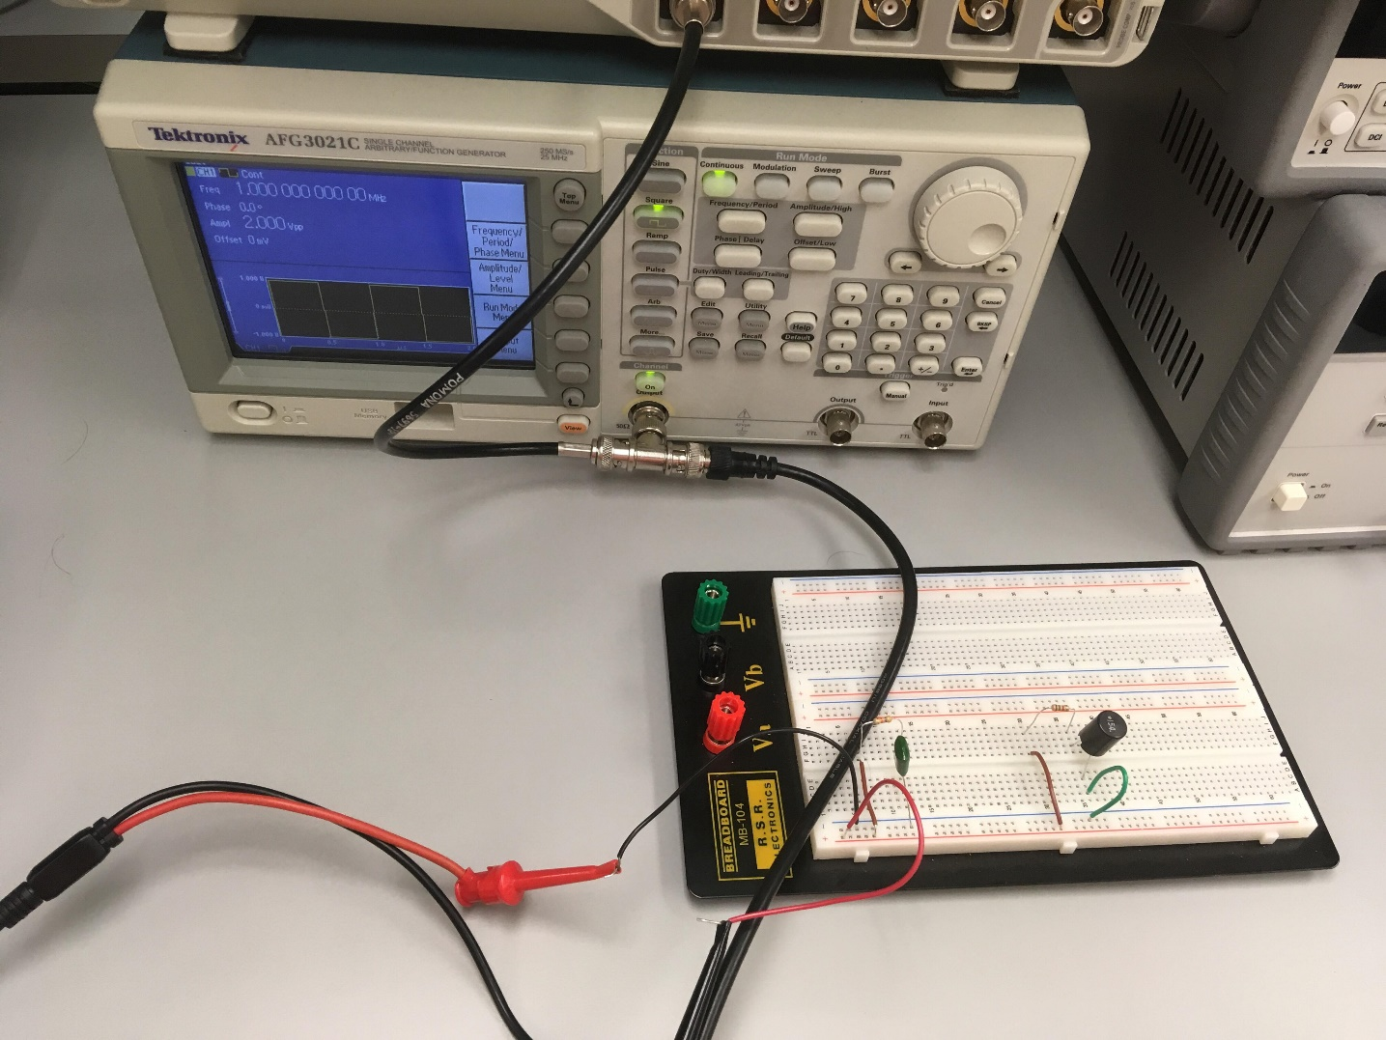
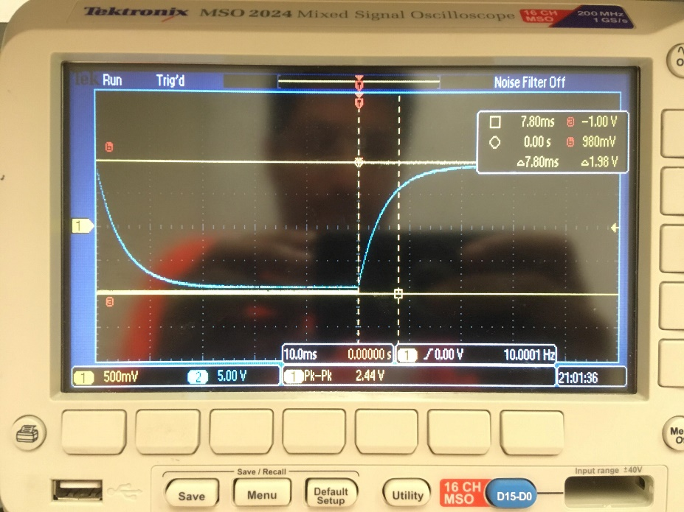
T-joint
Make sure to see the function generator output and check the peak to peak value by moving cursors accordingly

